Slide 1
DATA ANALYSIS TEAM3 Term Project
Mudliar, Rahul
Karani, Mercy Khalil,
Muhammad Faizan
Lopez Atuesta, Juan
TEC437

Slide 2
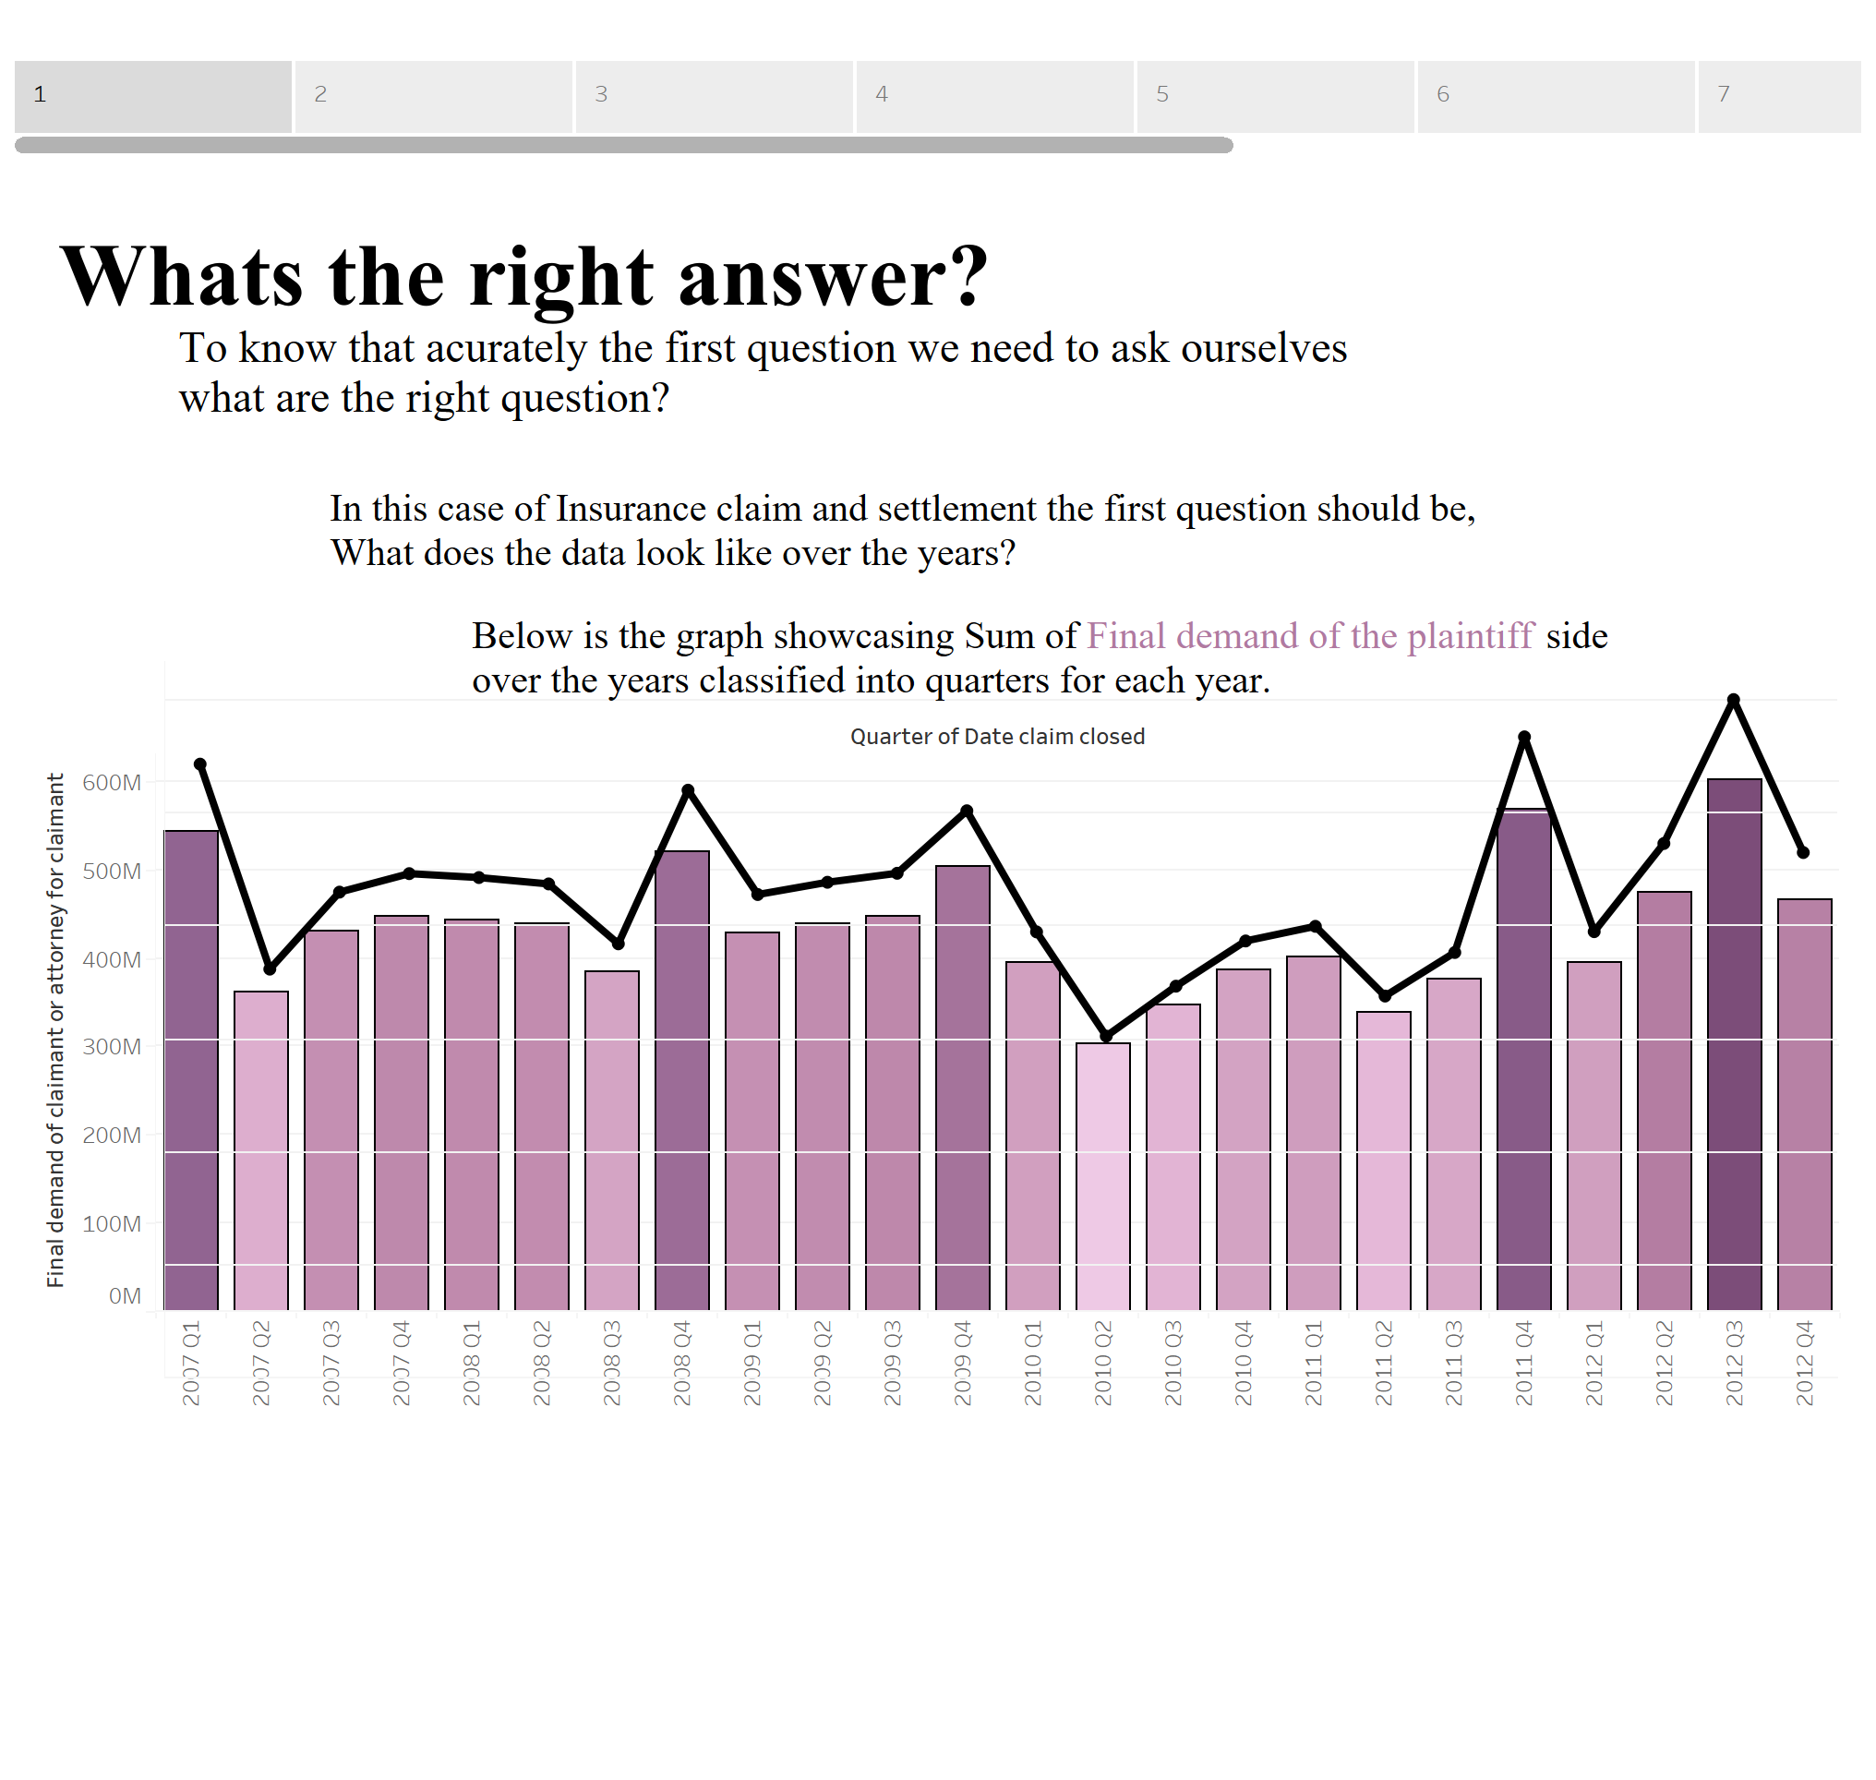

Slide 3
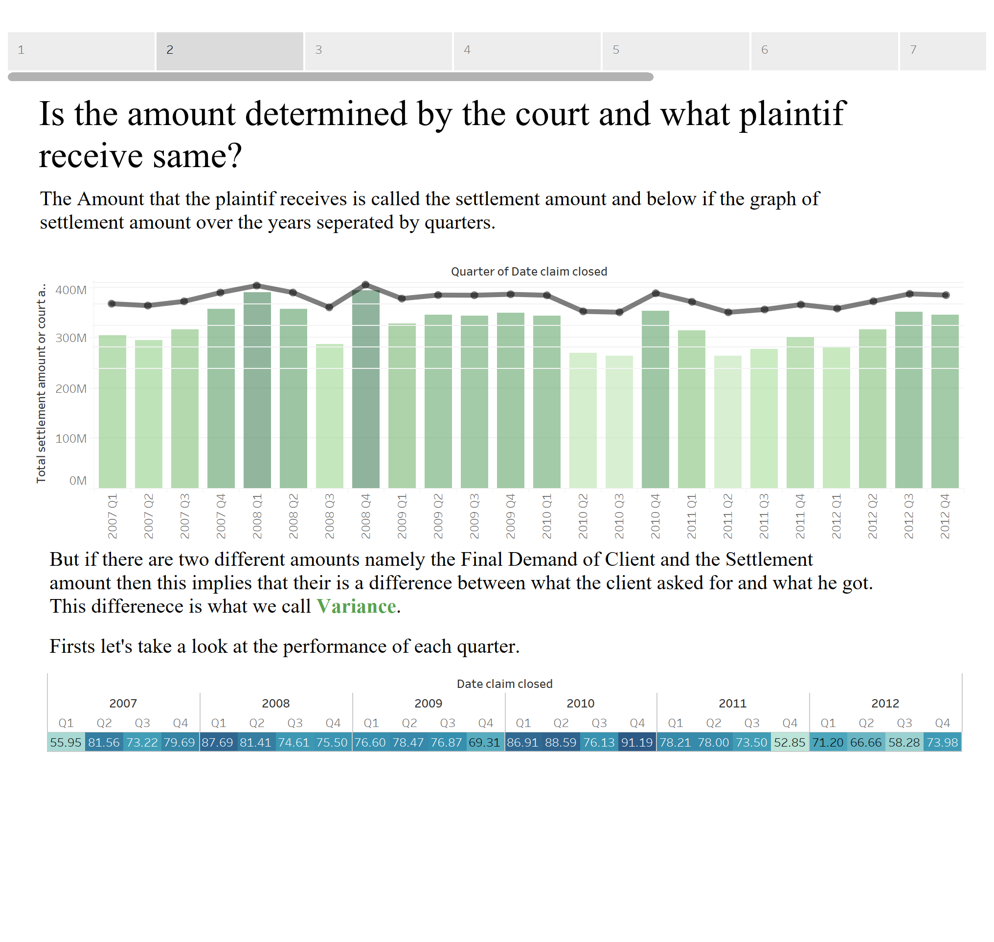

Slide 4
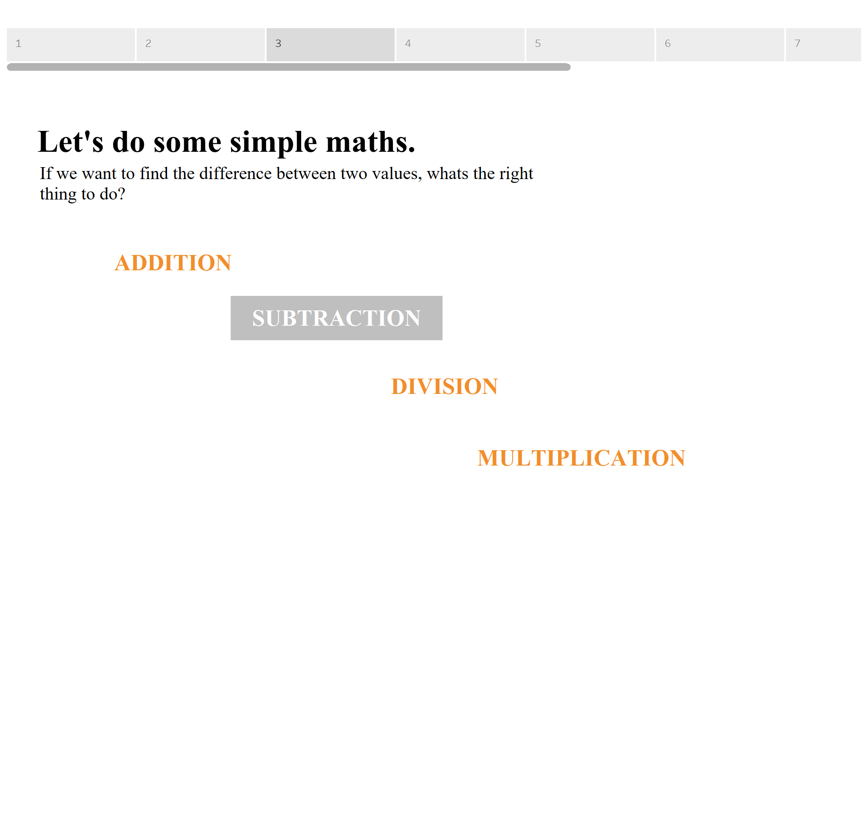

Slide 5
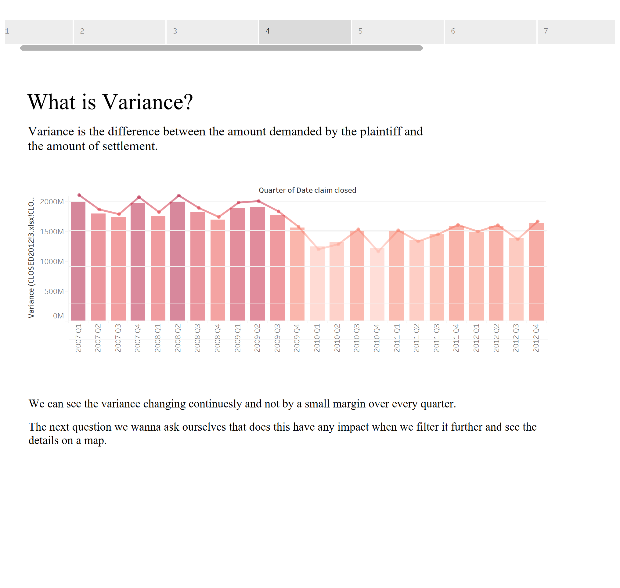

Slide 6
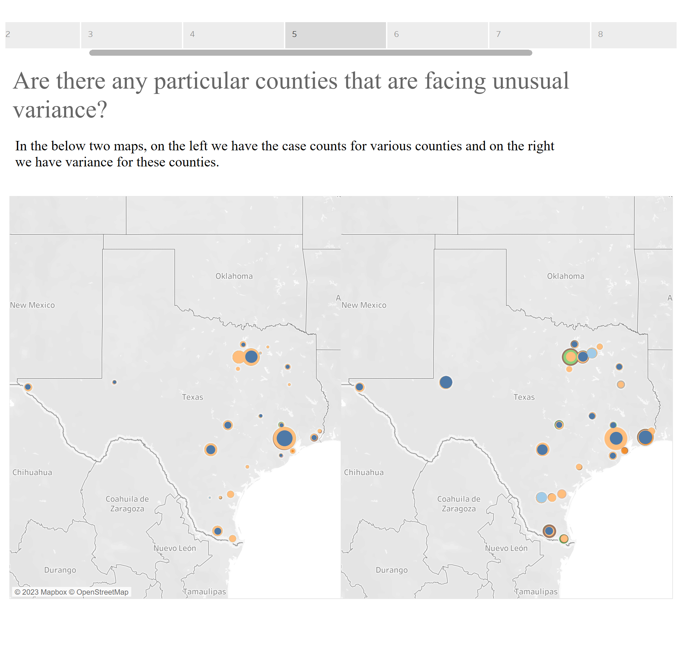

Slide 7
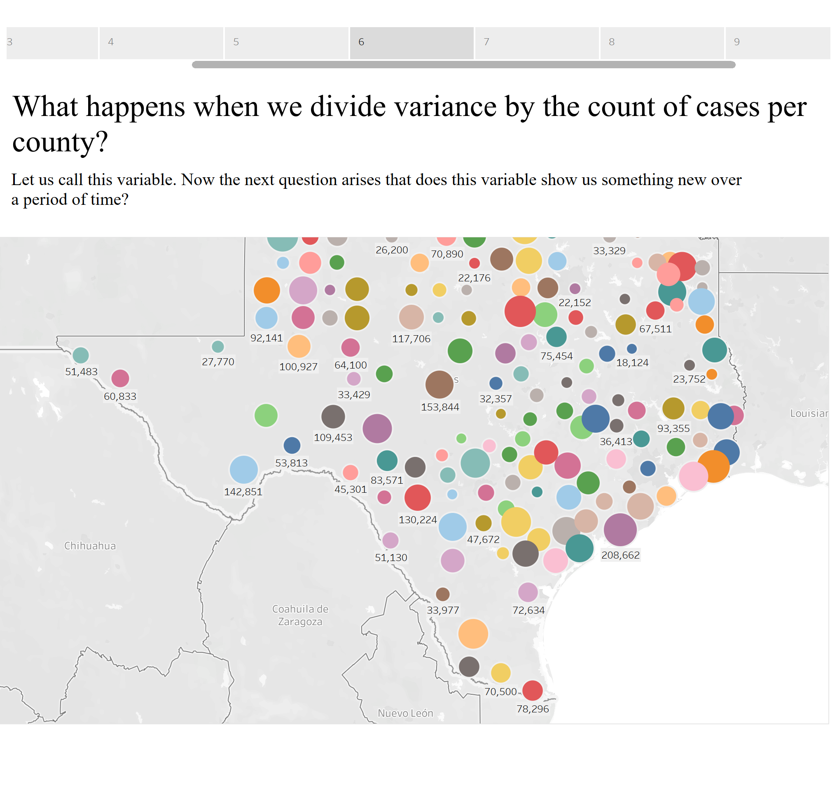

Slide 8
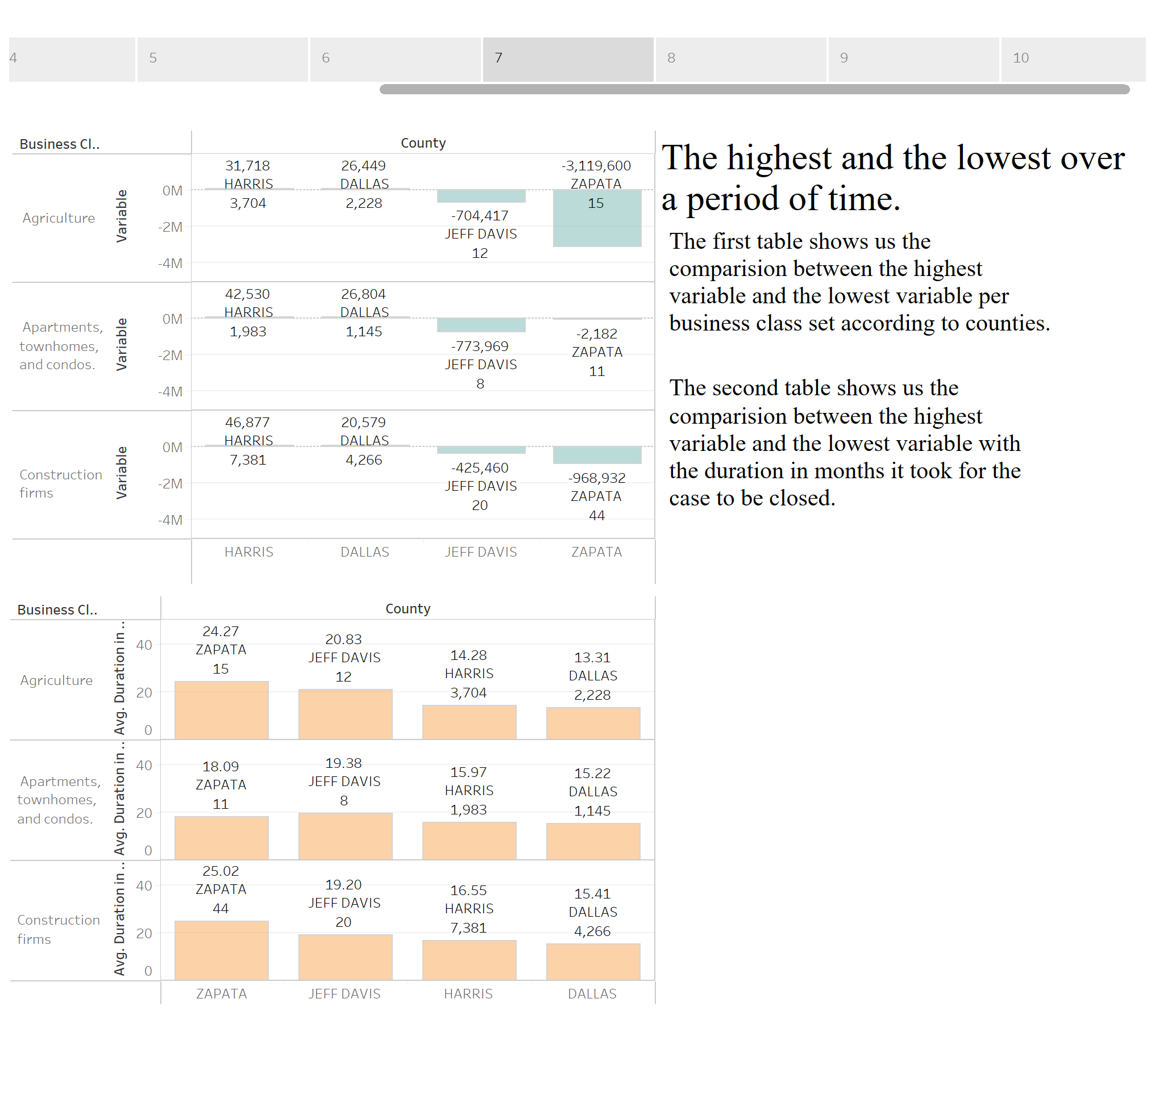

Slide 9
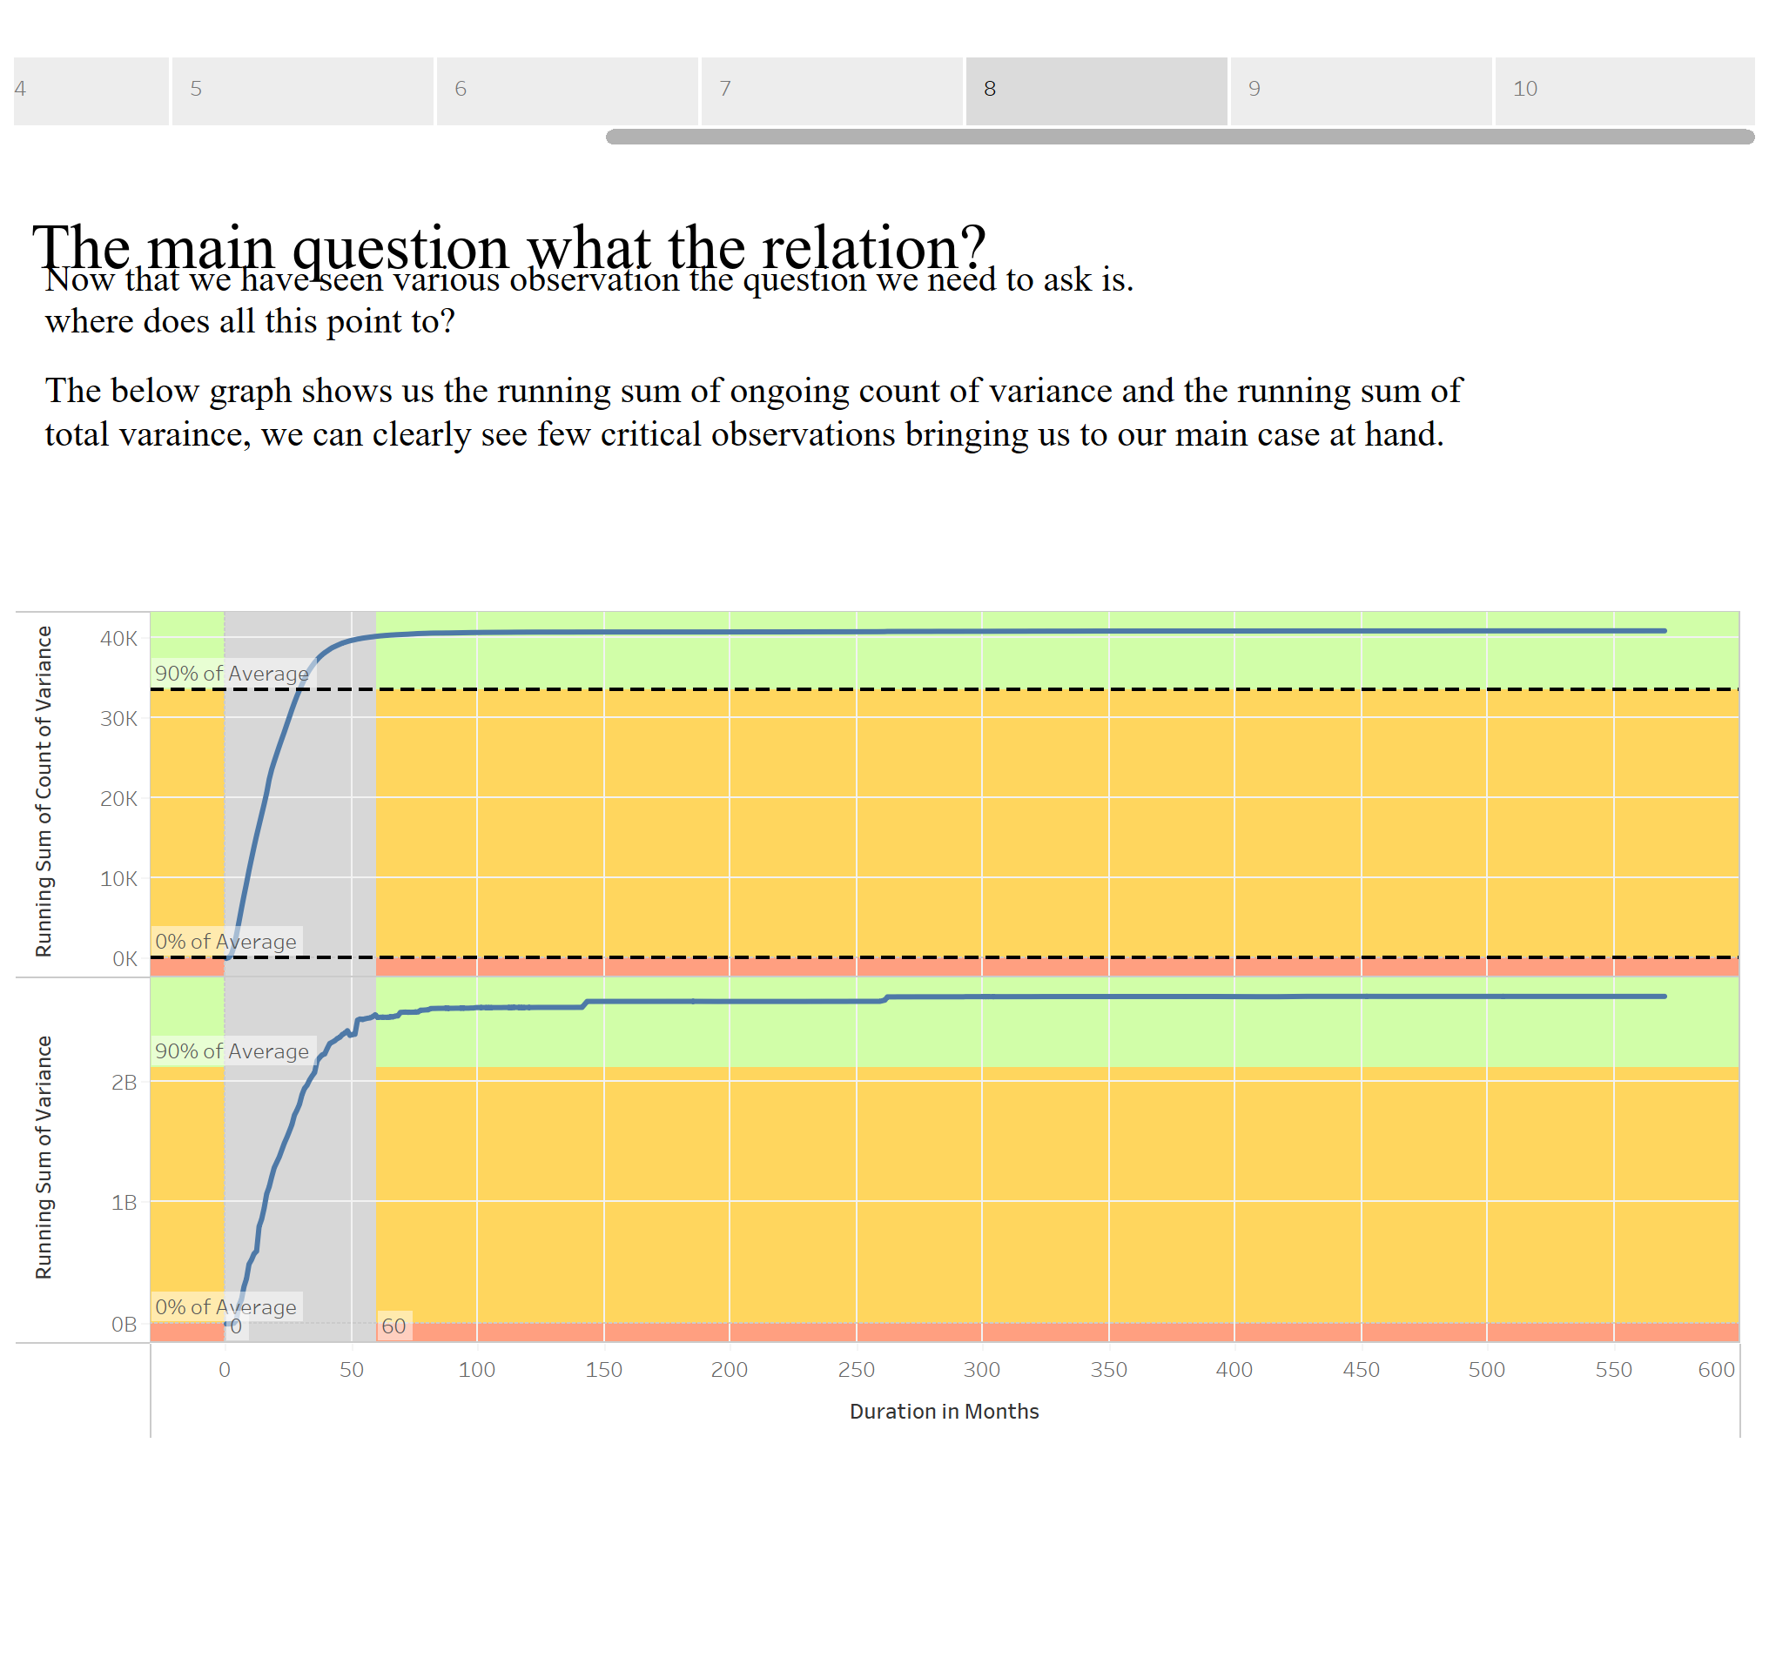

Slide 10
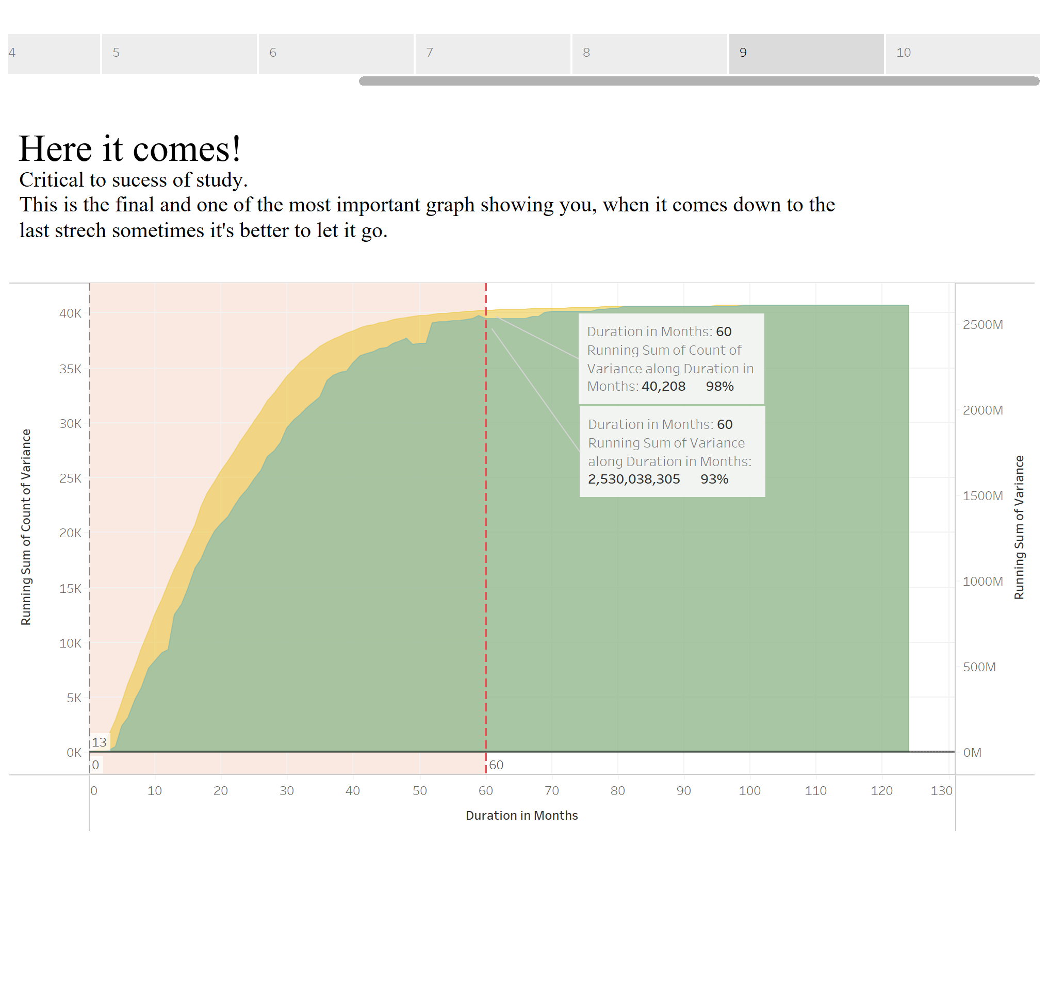

Slide 11
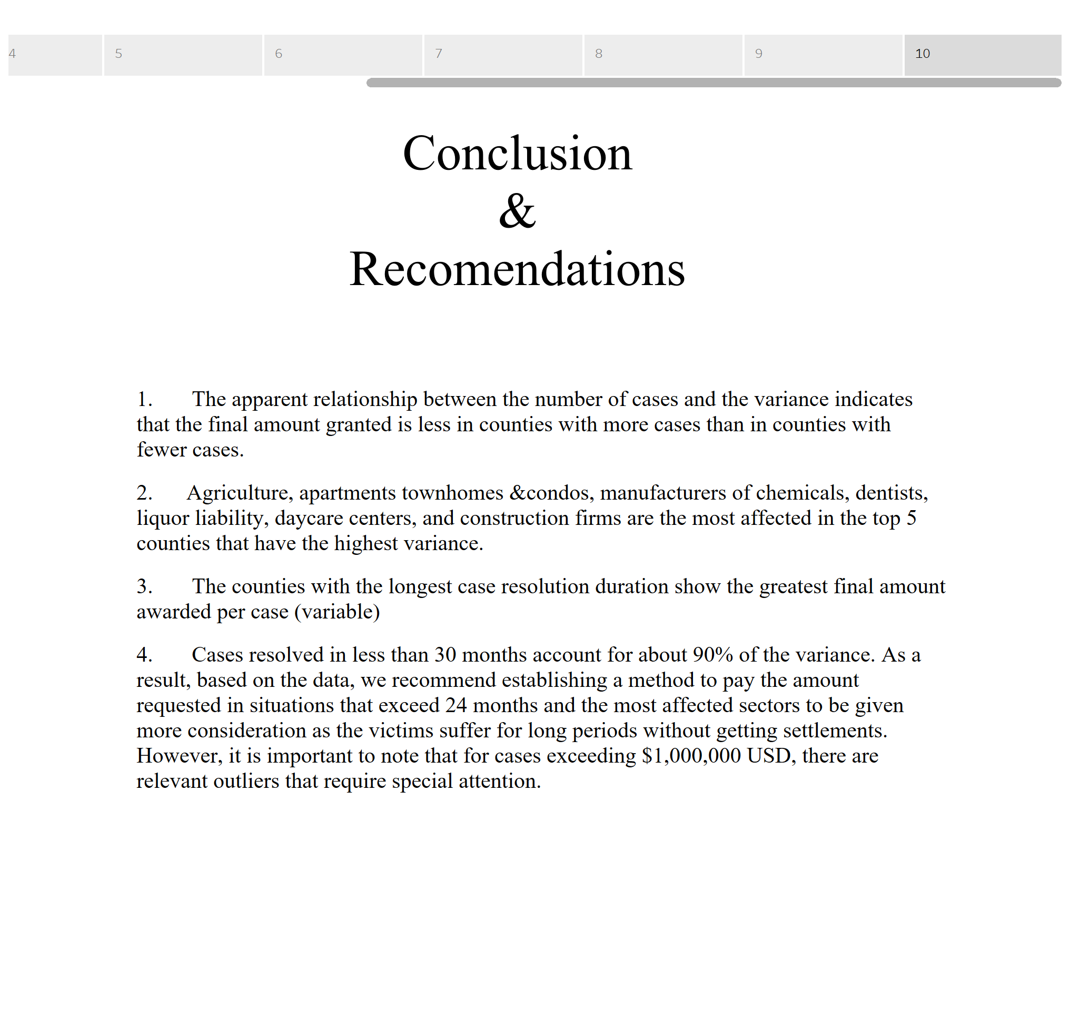

Slide 12
Data References
Insurance, T. D. (2023, 4 25). TDI. Retrieved from Property and Casualty Reports: https://www.tdi.texas.gov/reports/report4.html#closed
U.S. Census Bureau, P. D. (2020, 01 08). TEXAS STATE LIBRARY and ARCHIVES COMMISSION. Retrieved from Population Estimates for Texas Counties, 2010-2017: Arranged in Descending Order: https://www.tsl.texas.gov/ref/abouttx/popcnty201011.html

